Slide 1
Return to Skating
June 19 2020

Slide 2
Stage 2 Relaunch Phase one Return to Skating
Dance will resume Monday June 22 at EDGE
Singles skating will return Monday June 29 at EDGE and Optimist George Blunden arena
Jimmie Condon is scheduled to reopen in August
Skating will look a little different moving forward
Mandatory forms (link on Calalta Website)
SKATE CANADA ASSUMPTION OF RISK AND WAIVER
DAILY HEALTH SCREENING CHECKLIST
CONTACT TRACING LOG FOR SKATERS/COACHES/VOLUNTEERS

Slide 3
Sessions will be registered through your coach
Sessions will be restricted to 18 skaters
We are not using Uplifter to allow for maximum flexibility – No pick ups allowed at this time
We will use your credits to pay for your sessions
If you don’t have credits you can purchase gift certificates in Uplifter under products in $100 denominations
Coaches will access the registration through an online link
Cost per session week #1 - $18.00 per session
Cost per 45 minute session singles skaters will be determined after we receive the permit

Slide 4
New protocols – Before you leave home
DO NOT leave home if you are feeling unwell or showing signs of COVID-19 Symptoms (Fever, Cough, Shortness of Breath, Sore Throat or Runny Nose) Skaters arrive rink ready
Eat before you come, if you take food please ensure it is self-contained, do not share
Thoroughly wash your hands with soap and warm water
Thoroughly wash water bottles with soap and warm water
Bring your own personal hand sanitizer
Thoroughly wash training clothes and accessories including gloves, hard guards, blade rag etc. daily
Use the washroom
Sign Skate Canada Assumption of Risk and Waiver either online or bring a signed copy to the arena prior to or at the first session you are registered for
Complete the online health screening and contact tracing form
No earlier than one hour before you skate

Slide 5
Screening Checklist/Tracing Form – Everyday (Online)
1 | Does the person attending the activity, have any of the below symptoms | CIRCLE ONE
 | Fever | YES | NO
 | Cough | YES | NO
 | Shortness of Breath/Difficulty Breathing | YES | NO
 | Sore throat | YES | NO
 | Chills | YES | NO
 | Painful swallowing | YES | NO
 | Runny Nose/Nasal Congestion | YES | NO
 | Feeling unwell/ Fatigued | YES | NO
 | Nausea / Vomiting / Diarrhea | YES | NO
 | Unexplained loss of appetite | YES | NO
 | Loss of sense of taste or smell | YES | NO
 | Muscle / Joint aches | YES | NO
 | Headache | YES | NO
 | Conjunctivitis | YES | NO
2 | Have you, or anyone in your household, travelled outside of Canada in the last 14 days? | YES | NO
3 | Have you or your children attending the activity had close “unprotected” contact (face to face contact within 2 metres/6 ft) with someone who is ill with cough and/or fever? | YES | NO
4 | Have you or anyone in your household been in close unprotected contact in the last 14 days with someone who is being investigated or confirmed to be a case of COVID-19? | YES | NO

Slide 6
Arrival at the Arena
Arrive at facility no more than 15 minutes prior to scheduled ice session
Enter through established entrances and follow signs
Changeroom will be closed, Skaters arrive rink ready
Place your skates / gloves on outside, in your vehicle, if possible. Leave your skate bag and shoes in your vehicle if possible
Skaters arrive rink ready (you can warm up outside respecting physical distancing)
Skaters will bring their own personal items, tissue, water bottle, gloves, hand sanitizer
Wash your hands with soap & water or sanitize using hand sanitizer
Music must be downloaded on a portable device. CDs will not be played
No spectators allowed in facility (week 1)

Slide 7
Sickness Policy
Skaters, coaches, staff, volunteers, parents or guardians cannot come to Calalta programming if they are sick or feel unwell, even if symptoms resemble a mild cold
If your child develops symptoms while at Calalta programming, they will be isolated from others and a parent or guardian must be available to pick them up immediately
Cleaning and disinfecting of all equipment and surfaces that may have come into contact with the symptomatic participant
Performance of hand hygiene by remaining participants
Consideration of suspension or temporary cancellation of the event

Slide 8
Sickness policy continued
If your skater develops COVID-19 symptoms notify your coach who will cancel your session(s) (you will not be charged for cancelled sessions due to COVID-19 sickness)
You can return to skating once it has been proven you are free of the COVID-19 virus as verified by a medical professional
Positive tests must be reported to the club who will report to the Section and facility. We will follow AHS directives however it is possible that participants may be removed until the diagnosis of COVID-19 has been ruled out by health authorities

Slide 9
First Aid
Designated Responder to oversee each session and activate response plan as needed:
Parent is to be first point of contact for first aid if possible.
Coach is secondary responder in case of emergency. Coach must be attired in a mask and gloves using proper protocols of donning of PPE before attending skater.
Coach moves skater to personal seating space if needed.
Designated responder contacts guardians and if needed Emergency responders. Coach to gather skater and their personal effects, and walk skater to meet their ride.
Coach is responsible to fill out the Incident Report form on the Skate Canada website. (No paper documents) https://skatecanada.wufoo.com/forms/qrkdnw40ve6pyn/

Slide 10
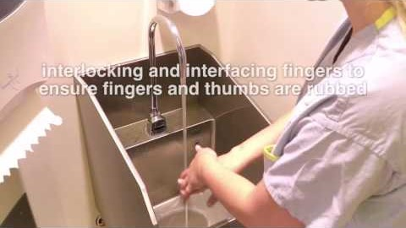
Hand Hygiene – Wash your hands often

Slide 11
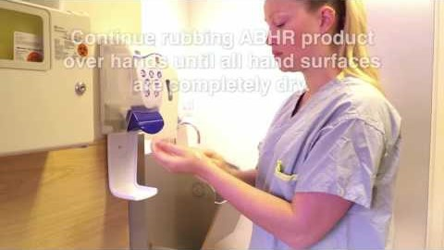
How to use Alcohol Based Hand Rub

Slide 12
Communication
*Coaches are to be the role models for the skaters and their parents
maintaining social distancing where possible, ensuring all required forms are filled out correctly in advance of taking the ice and following all hand washing and hygiene practices.
If the guidelines set by SkateCanada Alberta and AHS are not followed, we could be shut down.
It is imperative that all coaches, skaters and parents abide by these regulations.
It was encouraged by the section to start with a small, manageable test group before opening to all members. This ensures that our policies are organized and working by the time we are at the allowed capacity.
If any coach, skater or parent is found to be non compliant with these guidelines they will be asked to leave or not permitted into the facility.
*The coaches in charge of Covid enforcement are:
Edge mornings-Tyler Myles
Edge afternoons-Jeff Langdon
Optimist daytime-Jaime-Lyn Jackson
Optimist Evenings-Andrea St. Cyr

Slide 13
Communication
The best form of communication between the club and the coaches is email.
The role of the coach with regard to communication with the skater is as follows:
Ensure schedule is clearly communicated
Make sure the skater knows where to warmup/cool down, when to enter and exit the facility, where to be during ice resurfaces and how music will be played.
The skaters must maintain social distancing requirements and practice safe hygiene/respiratory practices, the coach will ensure this takes place.

Slide 14
PRACTICE PHYSICAL DISTANCING
Keep at least 2 meters (about the length of a hockey stick) between you and others.
If you are too close to someone who coughs or sneezes, you risk breathing in tiny droplets that could contain the COVID-19 virus.

Slide 15
Stay Safe Together
Q and A
June 19 2020

